Slide 1


Data Structure
Dr Swati Gupta & Ms Suman
Faculty
School of Engineering & Technology
K.R. Mangalam University
Unit 4 : Sorting and Searching
Dr. Shahjad

Slide 2


Session 37
Quick Sort
Choosing the pivot element in Quick
Sort
Example of Quick Sort
Algorithm of Quick Sort
Complexity Analysis of all the Sorting Algorithm
Brainstorming Session

Slide 3

Recap
Merge sort is a sorting algorithm that uses this approach. In Merge Sort we will:
DIVIDE : Split an array into parts recursively into half.
CONQUER : Sort the sub-arrays individually.
COMBINE : Merge the sorted sub-arrays to get a big sorted array

Slide 4

Quick Sort
Quicksort is a sorting algorithm based on the Divide and Conquer algorithm
It picks an element as a pivot and partitions the given array around
the picked pivot by placing the pivot in its correct position in the
sorted array.
Unit2

Slide 5
Steps to Sort an Unsorted Array with Quick Sort Algorithm
Pivot Selection and Partition : Selects an element for partitioning around it and partition the array into two parts such that left part of the pivot contains elements less than pivot and right part contains elements greater than pivot.
Recursion in Quick Sort : Recursively executes above step on both
of the partitions(left,right) inividually till they get sorted.
Concatenation of the Sub-Arrays : Concatenate all the sub-arrays
according to their indices
Unit2

Slide 6
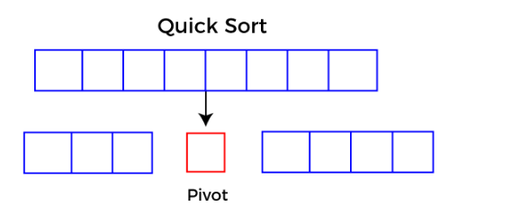
Choosing the pivot
Always pick first element as pivot
Always pick last element as pivot
Pick a random element as pivot
Pick median as pivot.
Unit2

Slide 7
Algorithm
QUICKSORT (array A, start, end)
{
if (start < end)
{
p = partition(A, start, end)
QUICKSORT (A, start, p - 1)
QUICKSORT (A, p + 1, end)
6 }
}
Unit2

Slide 8
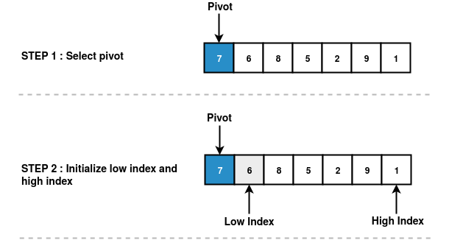
Pictorial Representation of Pivot Selection
Unit2

Slide 9
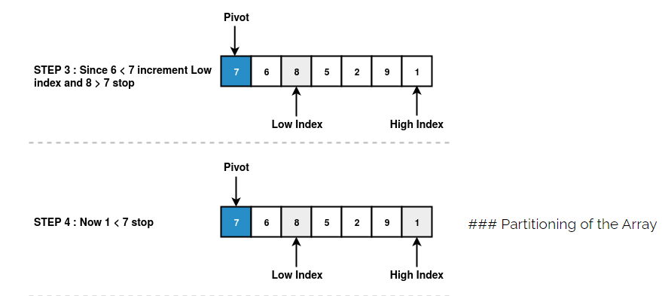
Pictorial Representation of Pivot Selection
Unit2

Slide 10
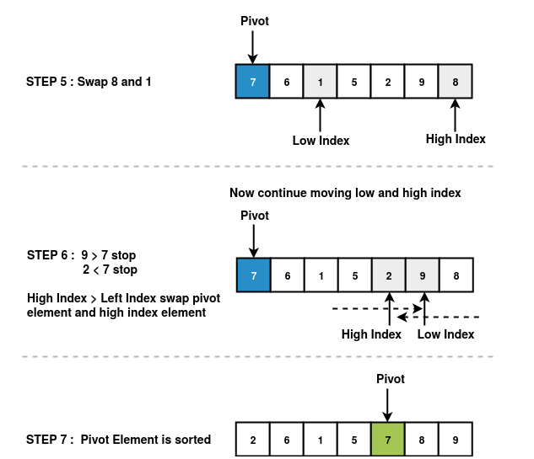
Pictorial Representation of Pivot Selection
Unit2

Slide 11
Quick Sort partition
The key process in Quick Sort is partition. Targets of partitions is, given an array and an element x of array as pivot, put x at its correct position in sorted array and put all smaller and equal elements (smaller than or equal to x) before x, and put all greater elements (greater than x) after x.
Partitioning array around the pivot means we divide the array into three parts
Partition-1 : Contains all elements of that array less than or equal to
pivot
Partition-2 : Contains only pivot
Partition-3 : Contains all elements of that array greater than pivot
Unit2

Slide 12
Steps to Partition an Unsorted Array
STEP 1 : First select a pivot in an unsorted array as shown above in the pivot selection
section
STEP 2 : Initialize the low index and high index. Low index represents the first index of
an array. High index represents the last index of an array.
STEP 3 : Start comparing low index element and high index element with the pivot. First start comparing with low index element with pivot element.
If low index element is less than the pivot element, increment low index
otherwise start comparing high index element with pivot element.
If high index element is greater than pivot element, decrement high index otherwise stop.
STEP 4 : Compare low index with high index.
If low index is less than high index swap low index element with the high index element.
If low index is greater than high index swap high index element with pivot index element.
STEP 5 : Repeat the steps 1 to 4 recursively for the sub-arrays until we get a sorted array.
Unit2

Slide 13
Partition Algorithm
PARTITION (array A, start, end)
{
pivot ? A[end]
i ? start-1
for j ? start to end -1 {
do if (A[j] < pivot) {
then i ? i + 1
swap A[i] with A[j]
}}
swap A[i+1] with A[end]
return i+1
}
Unit2

Slide 14
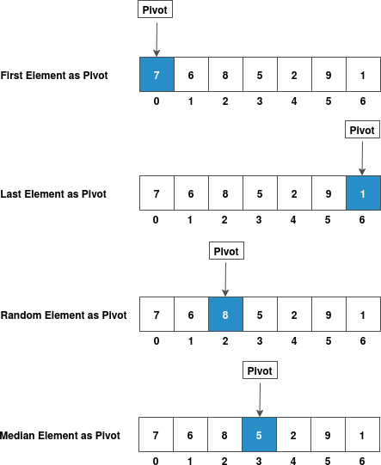
Pictorial Representation of Partitioning Unsorted Array
Unit2

Slide 15
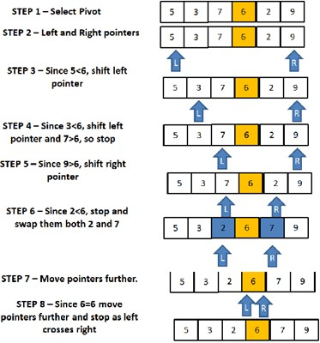
Example
https://www.guru99.com/quicksort-in-javascript.html
Unit2

Slide 16
Quick Sort
What is Recursion
On the given array we have to perform partition on that array and recursively on partition-1 and partition-3. But we have to stop at
some point i.e., we will stop when the partition is already sorted.
Remember that array containing one element is always sorted. So,
we proceed till the partition is of length one.
What is Concatenation
After all sub-arrays(partitions and their partitions and so on) are
sorted, we concatenate(place one after the other) all sub-arrays
according to their indices and that gives us the sorted-array.
Unit2

Slide 17
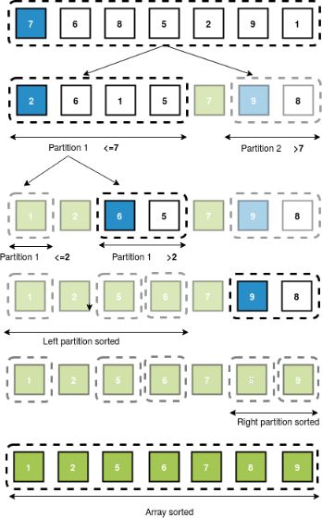
Quick Sort
Unit2

Slide 18
Quick Sort Analysis
Learning Objectives of this Module
In this module, we will be learning about:
Time and Space Complexity: We will learn about the running time of
the sorting process.
Comparison with other algorithms: We will compare quick sort with other sorting algorithms and see in which situations quick sort is the optimal approach to take.
Unit2

Slide 19
Quick Sort Analysis
Running Time of Quick Sort
The time taken by quick sort to sort an array either in ascending or
descending order generally depends upon the input array and partition strategy.
Following are three cases which we come across while sorting an array with quick sort algorithm:
Best Case
Worst Case
Average Case
Unit2

Slide 20
Quick Sort Analysis
Case | Description | Time Complexity
Best Case | Minimum levels of recursion, balanced splits | T(n)=nlogn
Worst Case | Already sorted array, unbalanced splits | T(n)=n2
Average Case | Uneven balanced partitions | T(n)=nlogn
Space Complexity Analysis
space complexity of Quicksort is O(n)
Unit2

Slide 21
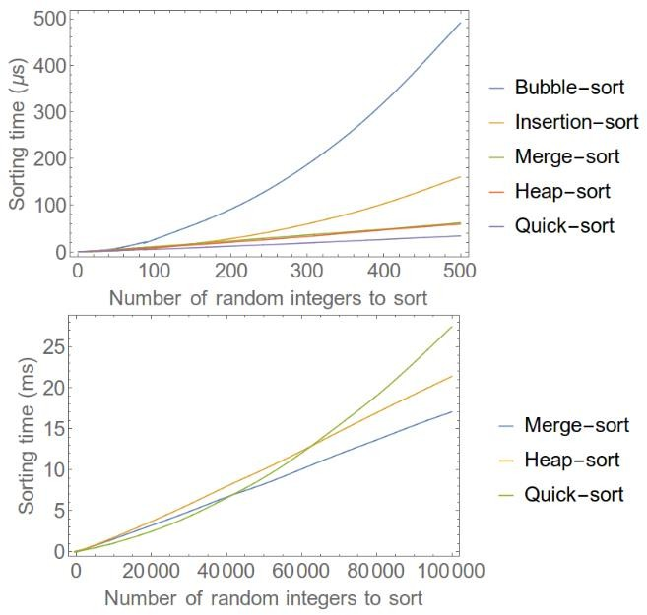
Comparison of Analysis
Unit2

Slide 22
Comparative Analysis of all the Sorting Algorithm
Algorithm Sort | Algorithm Average | Time Best | Time Worst | Features Space
Quicksort | O(n*log(n)) | O(n*log(n)) | O(n2) | Constant
Bubble sort | O(n2) | O(n2) | O(n2) | Constant
Selection Sort | O(n2) | O(n2) | O(n2) | Constant
Insertion Sort | O(n2) | O(n) | O(n2) | Constant
Heap Sort | O(n*log(n)) | O(n*log(n)) | O(n*log(n)) | Constant
Merge Sort | O(n*log(n)) | O(n*log(n)) | O(n*log(n)) | Depends
Unit2

Slide 23
Test Your Knowledge
Which of the following arrays are sorted in ascending order:
a: 10, 14, 18, 22, 98, 101, 123
b: 8, 7, 6, 5, 4, 3, 2, 1
c: 54, 55, 56, 58, 61, 60, 65
d: 1, 2, 3, 4, 5, 6, 7, 8
e: a and d
You are given the array [9, 5, 3, 8, 1, 2, 10, 11, 8, 12]. What is the index of 2 in it, if the array is 1-indexed?
a: 3
b: 4
c: 6
d: 8
Unit2

Slide 24
Test Your Knowledge
You are given the array [9, 5, 3, 8, 1, 2, 10, 11, 8, 12]. Which of the following are the indices of the elements in the order they appear in the sorted array (arg-sort of the array).
a: [1, 2, 3, 4, 5, 6, 7, 8, 9, 10]
b: [7, 4, 3, 5, 1, 2, 8, 9, 6, 10]
c: [5, 6, 3, 2, 4, 9, 1, 7, 8, 10]
d: [5, 6, 3, 2, 9, 4, 1, 7, 8, 10]
e: c and d
You are asked to sort an array. After the first iteration of quicksort (picking a median and partitioning the array), the result is [6, 4, 5, 3, 7, 9, 8, 11, 12]. Which of the following could have been the chosen pivot for this partitioning:
a: 7
b: 3
c: 11
d: 9
e: 12
f: a, c and e
Unit2

Slide 25
Test Your Knowledge
5. Function
quick_sort(array) -> sorted-array: if array is empty: return array pivot = choose_pivot_index()
smaller_array = [], bigger_array = [] for i = 1 to sizeof(array):
if ( A ):
append array[i] to smaller_array else if (-----B-----):
append array[i] to bigger_array
return quick_sort(smaller_array) + [array[pivot]] + quick_sort(bigger_array) Which of the following can be used to fill in the blank - (A) in the quick-sort algorithm
a: array[i] < array[pivot] b: array[i] > array[pivot] c: array[i] == array[pivot] d: array[i] != array[pivot
Unit2

Slide 26
Test Your Knowledge
6. Function
quick_sort(array) -> sorted-array: if array is empty: return array pivot = choose_pivot_index()
smaller_array = [], bigger_array = [] for i = 1 to sizeof(array):
if ( A ):
append array[i] to smaller_array else if (-----B-----):
append array[i] to bigger_array
return quick_sort(smaller_array) + [array[pivot]] + quick_sort(bigger_array) Which of the following can be used to fill in the blank - (B) in the quick-sort algorithm
a: array[i] <= array[pivot] b: array[i] >= array[pivot] c: array[i] == array[pivot] d: array[i] != array[pivot
Unit2

Slide 27
Test Your Knowledge
An array of 16 elements is already sorted. We always pick the first element of the array at each iteration of the sorting process as the pivot. How many recursions (layers) will it take for quicksort to terminate.
a: 1
b: 2
c: 4
d: 8
e: 16
If an array of 16 elements is sorted in decreasing order initially (opposite to how we want to sort). We always pick the middle element (the higher of the two in the middle if there is a tie) of the array at each iteration of the sorting process as the pivot. How many iterations will it take for quicksort to terminate?
a: 1
b: 2
c: 4
d: 8
e: 16
Unit2

Slide 28
Test Your Knowledge
Q9: Given the following list of numbers [14, 17, 13, 15, 19, 10, 3, 16, 9, 12] which answer shows the contents of the list after the second partitioning according to the quicksort algorithm?
[9, 3, 10, 13, 12]
[9, 3, 10, 13, 12, 14]
[9, 3, 10, 13, 12, 14, 17, 16, 15, 19]
[9, 3, 10, 13, 12, 14, 19, 16, 15, 17]
Q-10: Given the following list of numbers [1, 20, 11, 5, 2, 9, 16, 14, 13, 19] what
would be the first pivot value using the median of 3 method?
1
9
16
19
Unit2

Slide 29
Quiz Answers
Question number | Correct Options
1 | e
2 | c
3 | e
4 | e
5 | a
6 | b
7 | e
8 | c
9 | d
10 | b
Unit2

Slide 30
Practice Questions
Question : Here is an unsorted array. You must do a series of steps provided in the instruction box, until the array is completely sorted.
550
611
222
113
994
465
286
717
478
649
Unit2

Slide 31
Practice Questions
Question : Here is an unsorted array. You must do a series of steps provided in the instruction box, until the array is completely sorted. 910
541
52
713
944
195
816
427
158
389
Unit2

Slide 32
REVIEW
Quicksort is a sorting algorithm based on the Divide and Conquer
algorithm that picks an element as a pivot
How to Choose the Pivot
Always pick first element as pivot
Always pick last element as pivot
Pick a random element as pivot
Pick median as pivot.
Unit2

Slide 33

THANK YOU

